Slide 1

Classification as a QUBO problem
Nurali Bibolat

Slide 2

Introduction
Representing the search for optimal parameters (w, b) to construct the decision boundary
for classifying a linearly separable dataset, as a Quadratic Unconstrained Binary Optimization Problem
Use Grover’s Adaptive Search with Phase Encoding algorithm to find the bit-string combination that reduces the function value
Find the relevant constants for finding the optimal (w, b)

Slide 3

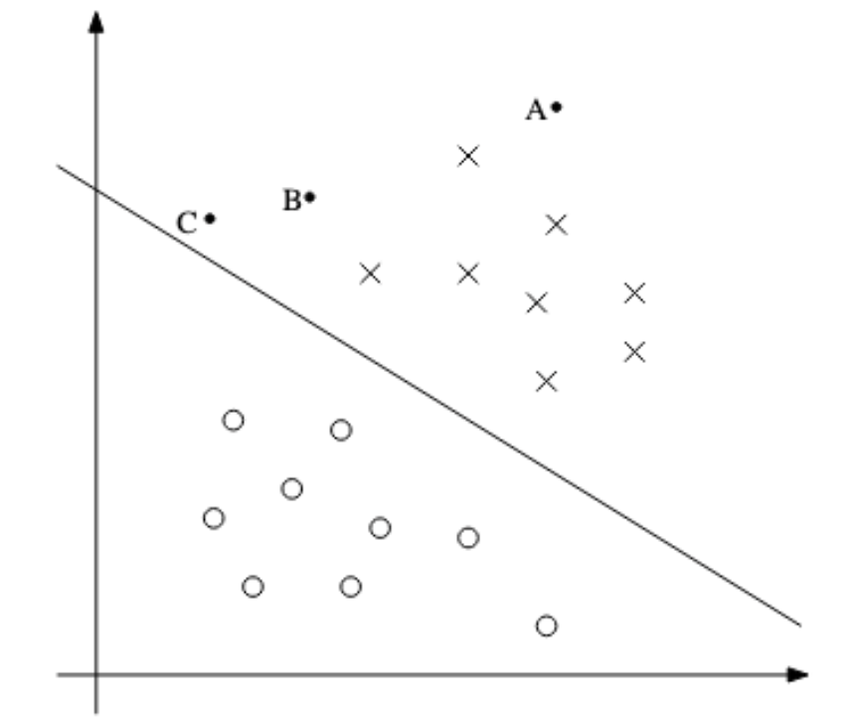






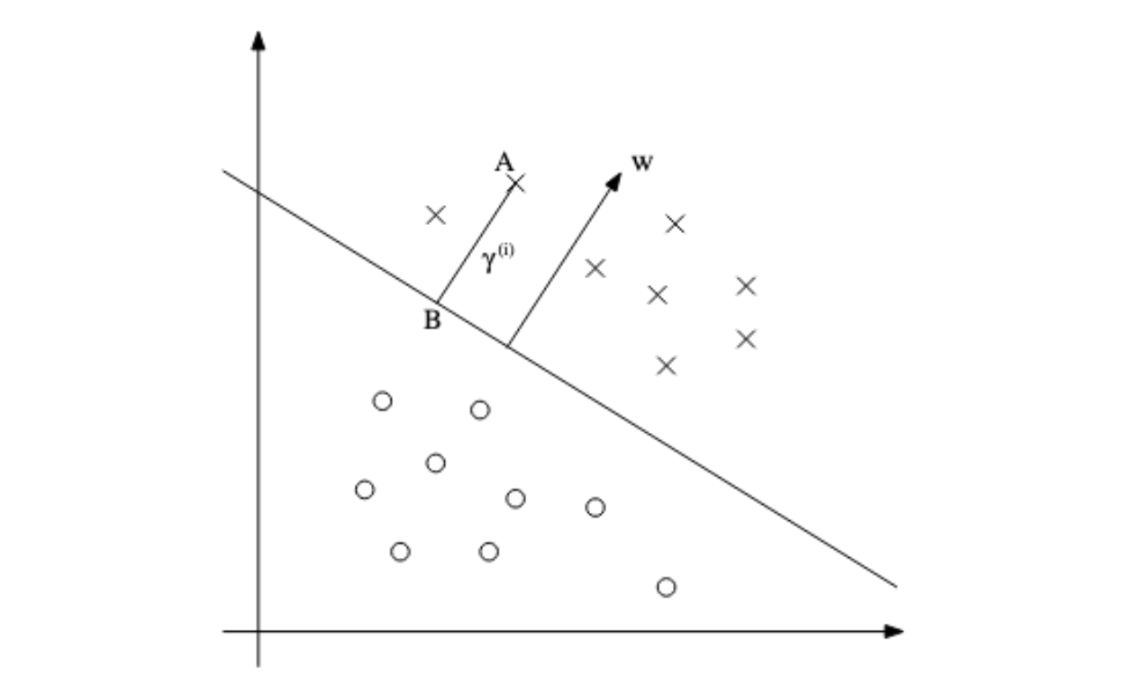

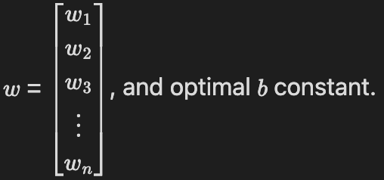
Classification
- Once the optimal weights and constants are found, a decision boundary is formed:
-
-
-
-
- either -1 or 1
- A classifier function, maps input data points to the output data points, by finding the optimal weights and constant
- Functional margin:
- Geometric margin:

Slide 4
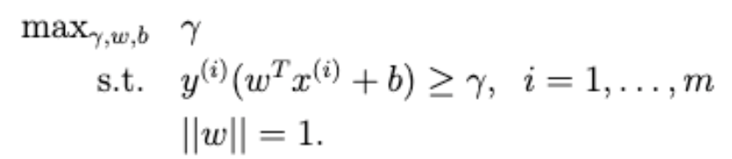
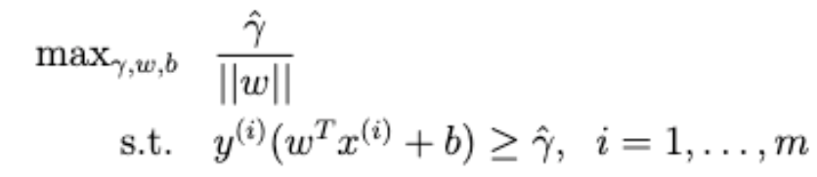

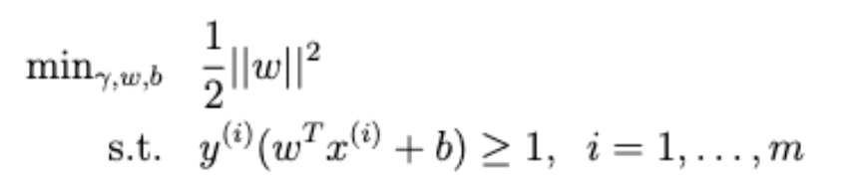
Optimization problem
Largest distance between data points and decision boundary
Further == more confident in prediction
(scale w, b)

Slide 5
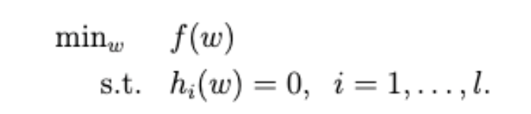
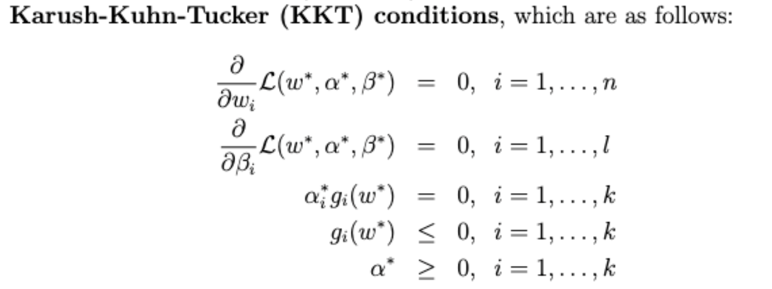
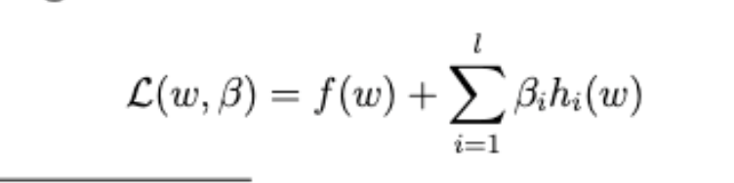
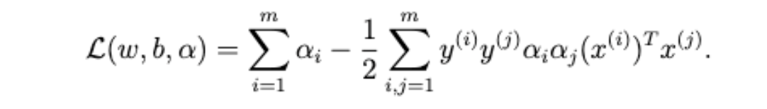


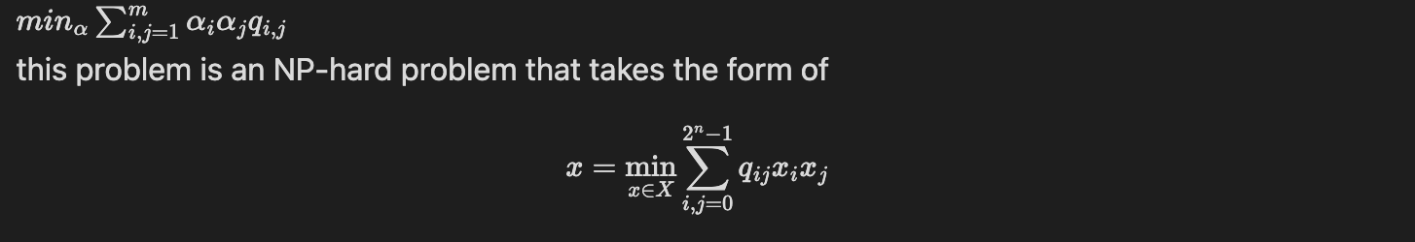
Lagrange multipliers + KKT
Derivation from: https://see.stanford.edu/materials/aimlcs229/cs229-notes3.pdf
Given the following optimization problem:
Maximize by varying alpha
Minimize:

Slide 6

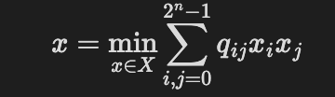
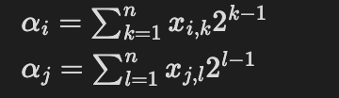
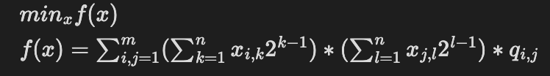
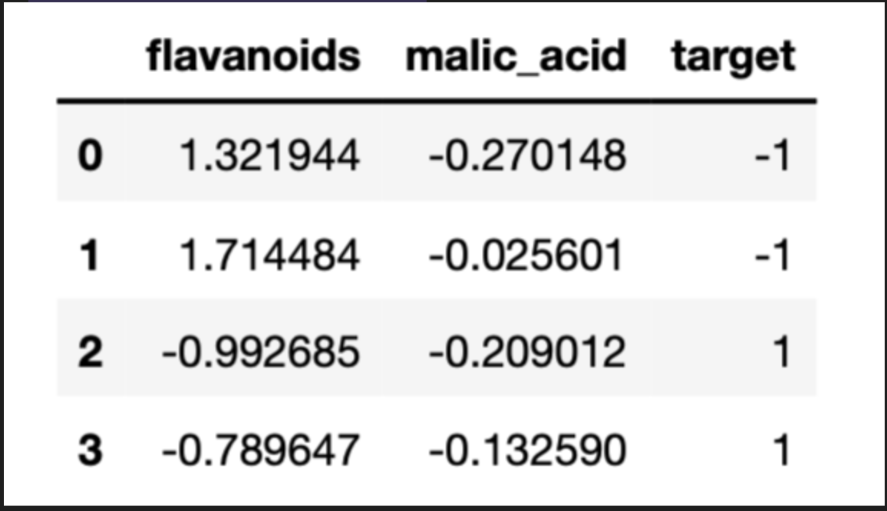
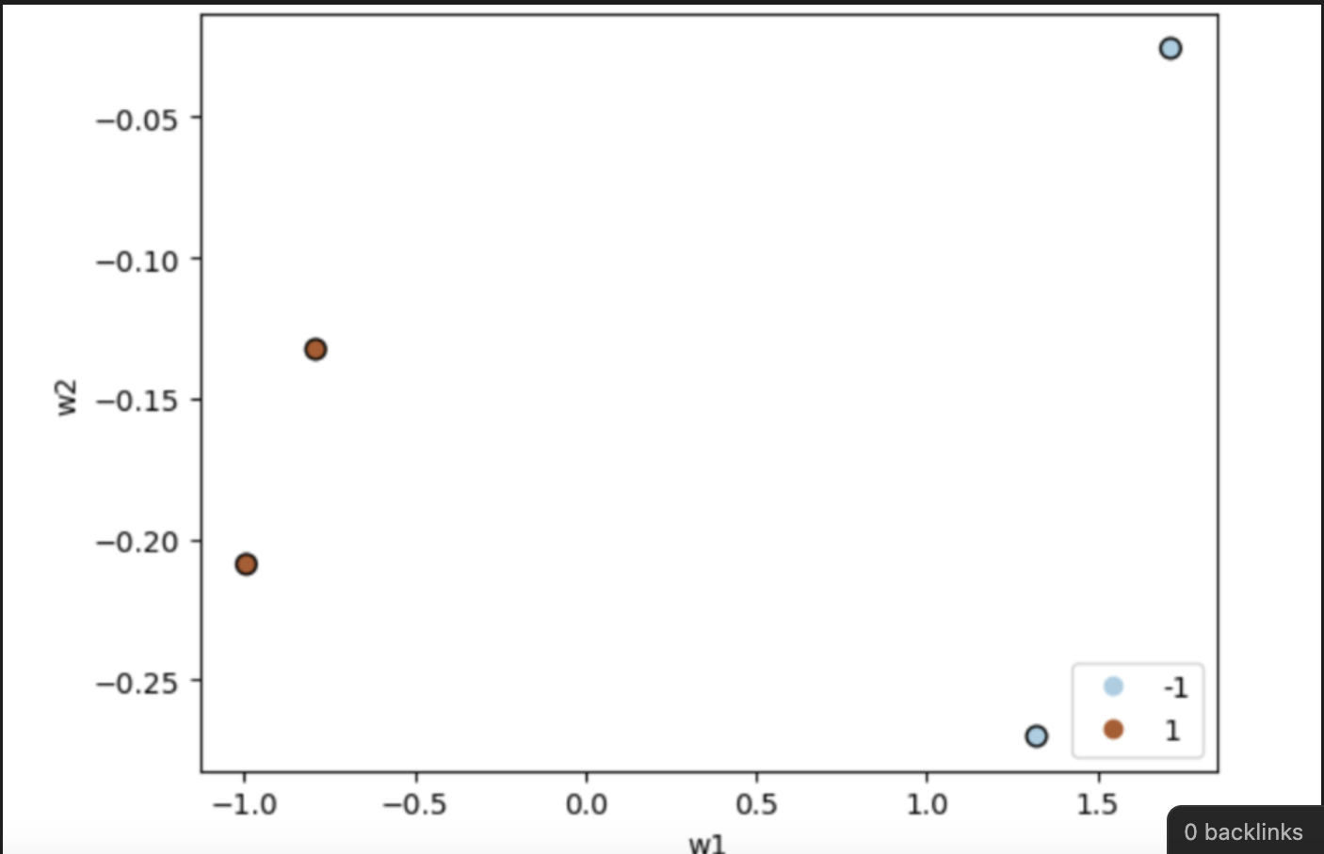
Converting to a QUBO problem
Example
12 + 13 = 25 qubits
Transpile(qc, backend) doesn’t work for more than 29
See whether a sensible boundary is constructed
(not horizontal)

Slide 7
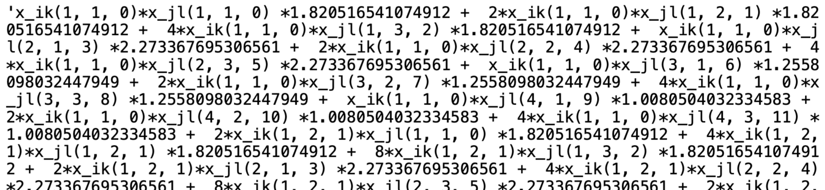
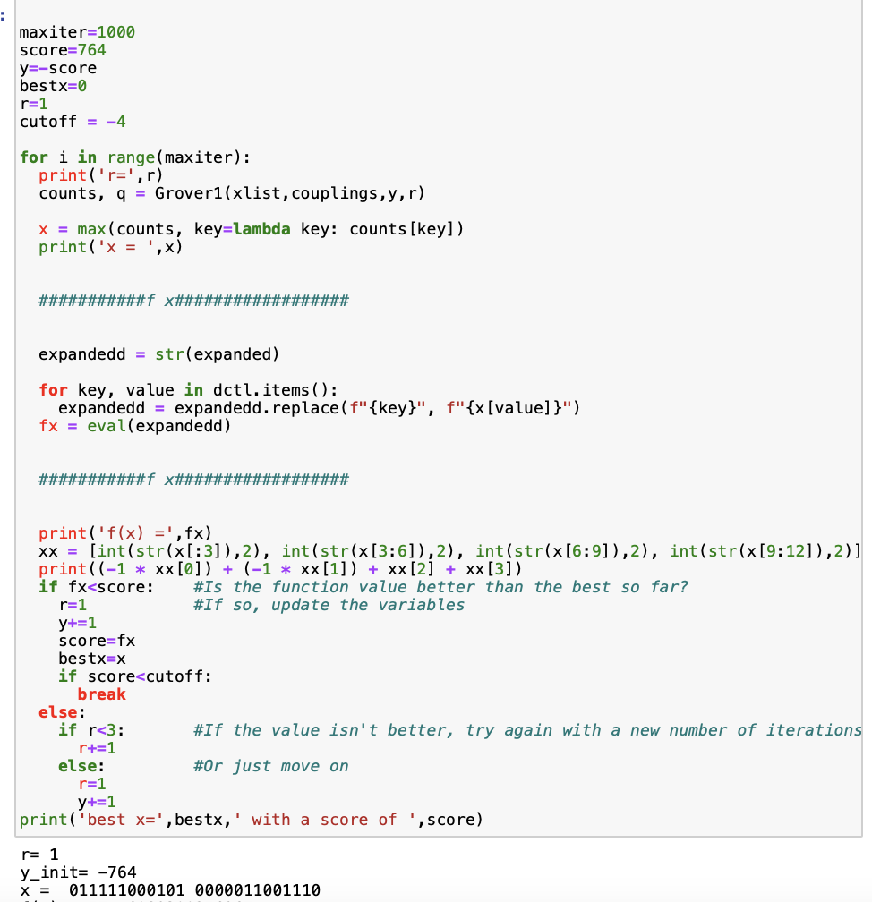
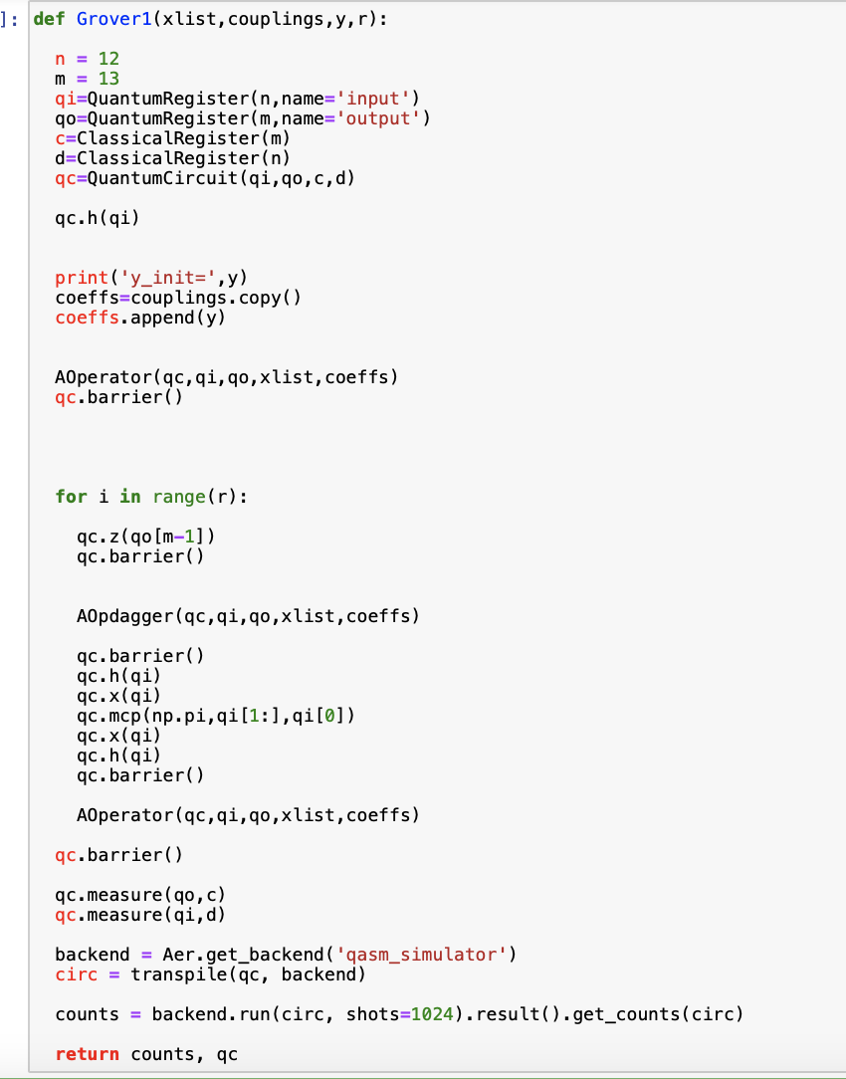
Example
Use the Grover's Adaptive Search with Phase Encoding algorithm
f(x) =

Slide 8
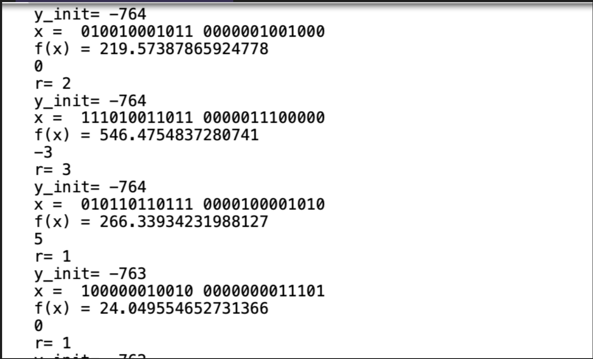

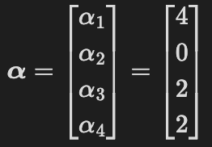
Example
Given amount of training data points (m) = 4, n = 3 qubits per each alpha (alpha can take max value of 7)
for each y_init, the algorithm takes about 3-3.5 minutes to output the x, f(x), , and r
Calculated x and f(x) from y_init = -778 to -708
Chose x = 100000010010 for which f(x) is very low relative to all other f(x), and satisfies other conditions

Slide 9
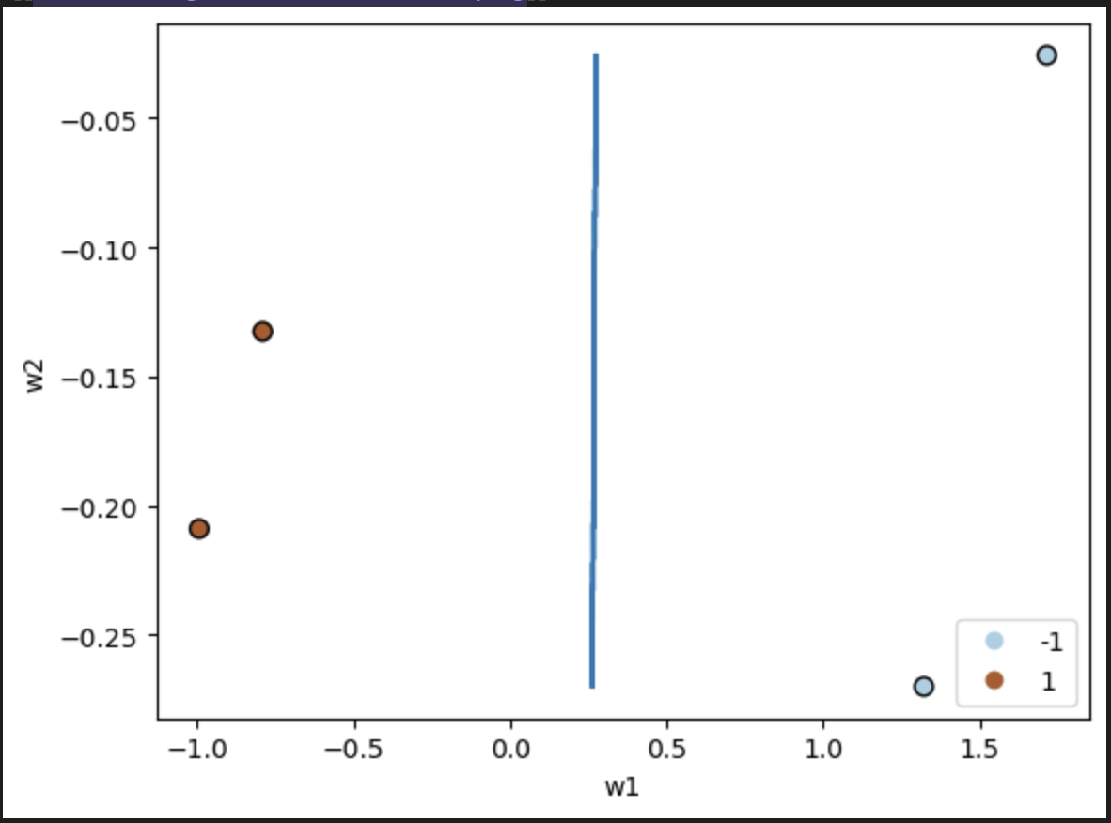
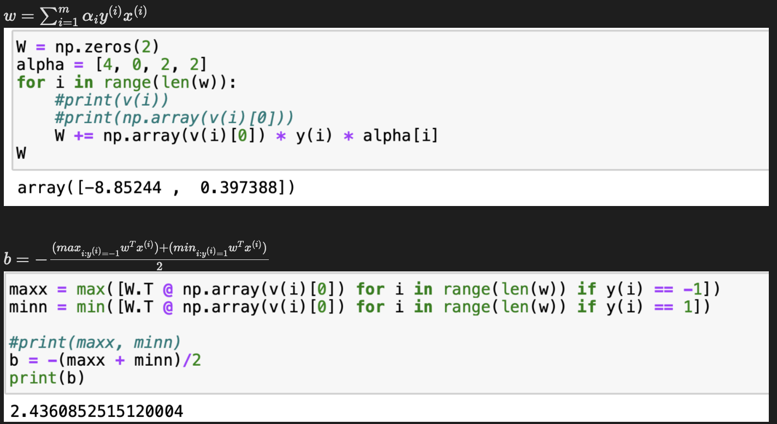
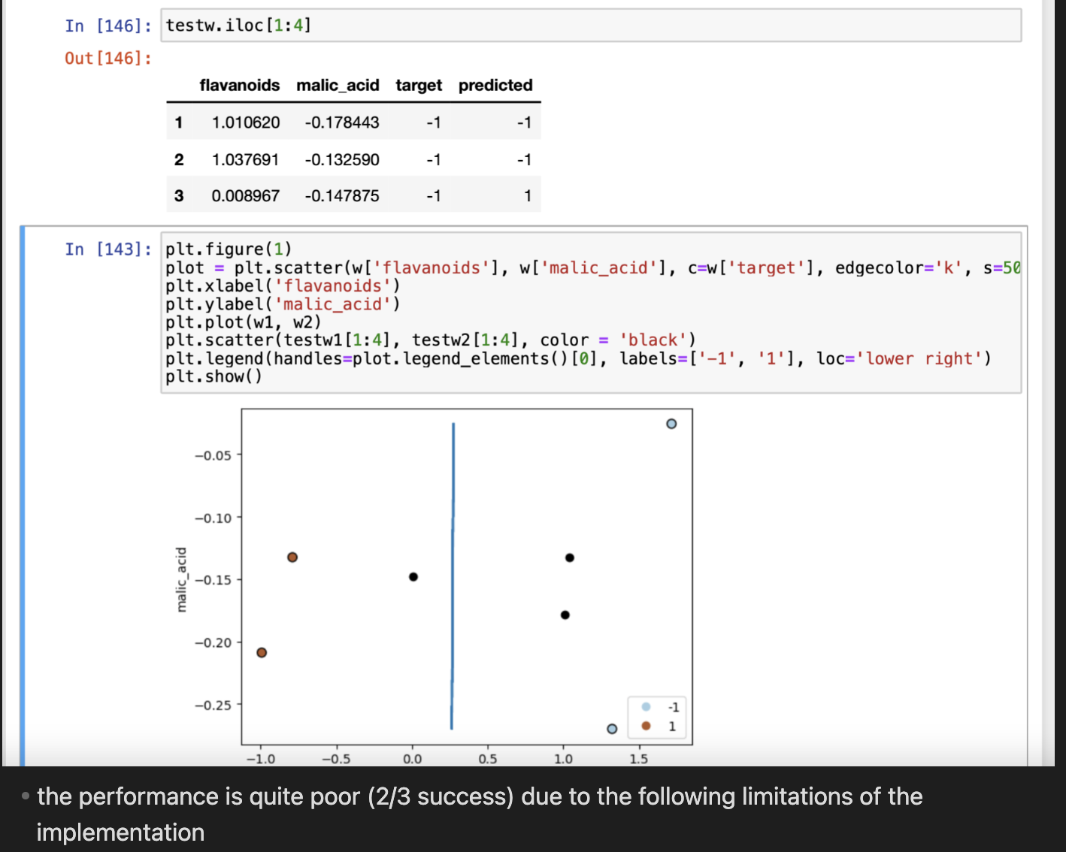
Results

Slide 10

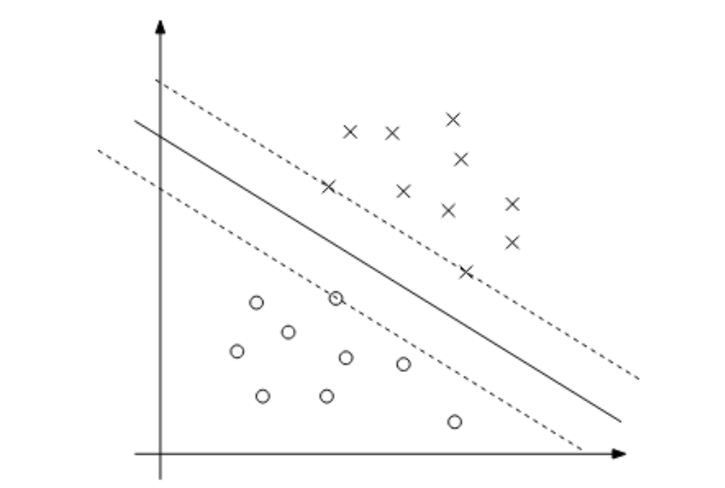

Errors
Algorithm with lagrange multipliers works best if we use data points with functional margins = 1 during training
At the optimal solution, KKT duality complementary conditions states that
→ occurs only for training data points that have functional margin = 1
- The implementation used data points with functional margins > 0, due to lack of training data points
- The three data points used ( = 1) are the support vectors
- used to create the optimal decision boundary for data points near it
- QUBO Support Vector implementation would utilize only these datapoints when constructing f(x)
Need more training data points
Only applicable for linearly separable datasets (no intersections)
Non-separable → reformulate the optimization problem again → new algorithms + Kernels → Support Vector Machines learning in high-dimensional feature space → ???

Slide 11
Thank you!
Source: https://see.stanford.edu/materials/aimlcs229/cs229-notes3.pdf
https://see.stanford.edu/Course/CS229/37

